Slide 1
Echocardiographic assessment
Morphological features
Hemodynamic characteristics

Slide 2
PRIMARY GOALS OF DOPPLER INTERROGATION
Assessment of obstruction of prosthetic valve
Detection and quantification of prosthetic valve regurgitation

Slide 3
TIMING OF ECHO CARDIOGRAPHIC FOLLOW-UP
Baseline postoperative TTE study should be performed 3-12weeks after surgery, when the
Chest wound has healed
Ventricular function has improved
Bioprosthetic valves Annual echocardiography after the first 10 years.
Mechanical valves routine annual echocardiography is not indicated in the absence of a change in clinical status

Slide 4
Morphologic and functional characteristics
Leaflet motion and occluder mobility
Acoustic shadowing
Microbubbles
Spontaneous echo contrast
Strands

Slide 5
Leaflet motion
Leaflet thickening (cusps >3 mm in thickness)-earliest sign
Calcification (bright echoes of the cusps)
tear (flail cusp).
Prosthetic valve dehiscence
Annular abscess echolucent, irregularly shaped area adjacent to the sewing ring
ECHOLUCENT AREA ADJASCENT TO SEWING RING ALMOST ALWAYS ABNORMAL

Slide 6
Mechanical valve in mitral position

Slide 7
Shadowing

Slide 8
Shadowing
LA/RA side of a prosthetic mitral/tricuspid valve is obscured by acoustic shadowing from the TTE
resulting in a low sensitivity for detection of prosthetic mitral or tricuspid regurgitation ,thrombus, pannus, or vegetation
TOE - superior images of the LA/RA side of the mitral/tricuspid prosthesis
In the aortic position, the posterior aspect of the valve appears shadowed on TTE while the anterior aspect of the valve is shadowed on TOE

Slide 9
ECHO FEATURES OF BILEAFLET VALVE
Both leaflets are typically visualized .
Opening angle 75⁰ to 90⁰
Closing position
120⁰ for valves ≤25 mm & 130⁰ for valves ≥27 mm
Three orifices are seen in diastole with highest
velocity from central orifice
Bileaflet have the largest EOA of all the mechanical valves (2.4–3.2 cm²) with little intrinsic mitral regurgitation (MR).

Slide 10
St.jude valve- Echo features

Slide 11
St.jude TTE

Slide 12
St.jude aortic TTE-

Slide 13
Ball and cage-echo

Slide 14
Bioprosthesis -echo features

Slide 15
Microbubbles
Discontinuous stream of rounded, strongly echogenic, fast-moving transient echoes
Occur at the LV inflow zone of the valve
when flow velocity and pressure suddenly drop at the time of prosthetic valve closing
Cavitation is the rapid formation and collapse of vapour filled bubbles caused by a transient reduction in local pressure below the vapour pressure of blood.
The implosion of these bubbles can damage the blood cells in the vicinity as well as activate the platelets
.
The cavitation potential correlateswith valve design, occluding material, and the velocity of the leaflet closure.
Common in the mitral position
Not found in bioprosthetic valves
Other mechanisms
carbon dioxide degassing and hypercoagulability of blood near the valve

Slide 17
Microbubbles

Slide 18
Strands
Thin, mildly echogenic, filamentous
<1 mm thick and >2 mm up to 30 mm length
move independently from the PHV
located at the LV inflow side of the PHV (i.e. the atrial side of a mitral prosthesis or the ventricular side of an aortic prosthesis).

Slide 19
Strands

Slide 20
Haemodynamic characteristics
Flow patterns (anterograde flows) and clicks
Quantitative parameters
Transprosthetic flow velocity and gradients
Effective orifice area
Doppler velocity index
Pressure recovery and localized high gradient
Physiologic regurgitation (retrograde flows)

Slide 21
Normal flow
Single disc-
large major orifice - dense and lower velocity jet
minor orifice -Higher velocity jet
Bileaflet
dense, lower velocity jet arising from the two lateral orifices
higher velocity jet arising from the central orifice
Ball and cage - blood flows goes around the entire circumference of the ball and gives two curved side jets and a large jet in the central part
Bioprosthesis - single central anterograde flow

Slide 24
Flow characteristics
Valve type | Flow Characteristics
Ball and cage prosthetic valve | Much obstruction and little leakage
Tilting disc prosthetic valve | Less obstruction and More leakage
Bi leaflet prosthetic valves | Less obstruction and More leakage
Bioprostheses | Little or no leakage
Homografts, pulmonary autografts, and unstented bioprosthetic valves | No obstruction to flow
Stented bioprostheses | Obstructive to flow

Slide 25
Flow velocity and pressure gradients
Bernoulli equation, the difference in pressure across a restrictive orifice is defined as: ΔP=P1−P2=4(V22−V12)
P1 and V1 are the pressure and velocity, respectively, proximal to the restrictive orifice
P2 and V2 are the pressure and velocity, respectively, distal to the orifice
Peak instantaneous gradient = Peak difference between pressures
Mean gradient = the average difference.
Since V₂ >> V₁ ,the energy balance through the orifice simplifies to: ΔP=4(V22)

Slide 26
Pitfalls
In bioprostheses, V₂ values may be low (often <2 m/s), so the use of the simplified Bernoulli equation can cause significant overestimation of pressure gradients
In these situations, estimation of the pressure gradient is more accurately determined by integrating the velocity proximal to the prosthesis into the Bernoulli equation
Valve size with the small prostheses have higher velocities
In patients with aortic prostheses and high cardiac output or narrow LV outflow tract (LVOT), the velocity proximal to the prosthesis may be elevated.

Slide 27
High gradient across the Prosthetic heart valve
Prosthetic valve stenosis or obstruction
Patient prosthesis mismatch (PPM)
High flow conditions
Prosthetic valve regurgitation
Localised high central jet velocity in bileaflet valves
Increased heart rate

Slide 28
Underestimation of gradients
Overestimation of gradients
1. Failure to align the Doppler beam parallel with the highest velocity jet
2. Low flow states
3. Elevated systemic blood pressure
1. Mistaking MR flow signal for transaortic flow signal (MR starts earlier and lasts longer than aortic flow)
2. High flow states
3. Pressure recovery
4. Localised high gradient in central jet

Slide 29
Localised high gradient in central jet(bi leaflet valve)

Slide 31
Preesure recovery

Slide 32
Pressure recovery phenomenon
The Aortic Pressure measured by cath Distal to the orifice Is higher than at the orifice
Therefore The AoV gradient measured by cath is LOWER then the the gradient measured by Doppler

Slide 33
Orifice areas

Slide 34
Effective orifice area (EOA)
EOA not equal to Geo.OA
EOA = Functional area
Transvalvular pressure gradients are essentially determined by the EOA
EOA corresponds to Vena contracta
EOA/GOA = Coeefficient of contraction
Coefficient of contraction varies from 0.90 to 0.71, which may result in up to a 29% difference between the EOA and GOA.

Slide 37
Effective orifice area

Slide 39
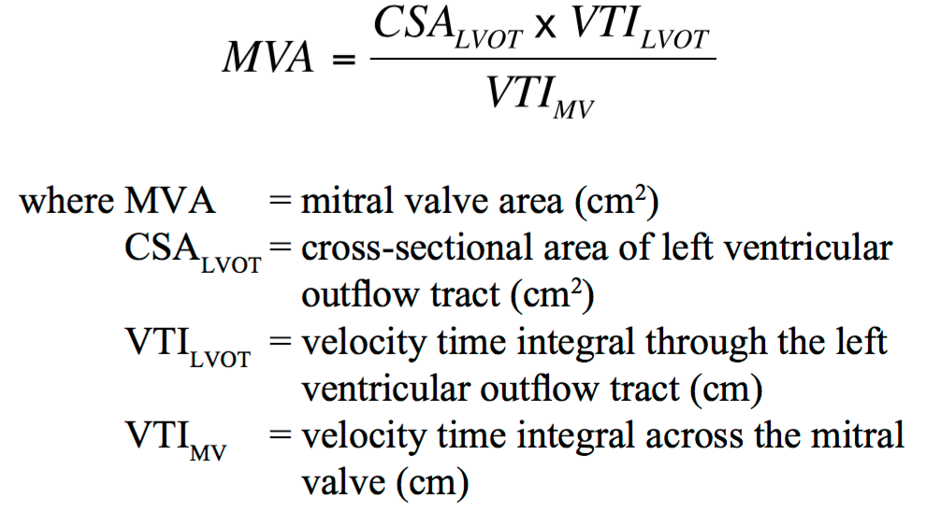
Mitral valve continuity equation

Slide 40
EOA -mitral valve

Slide 42
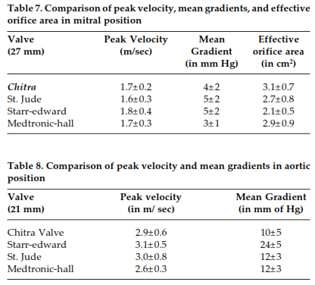
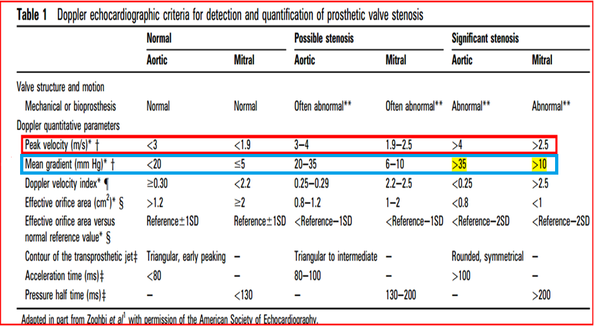
Prosthetic Heart valve Gradient calculation.
Equation
Δ P = 4V²
or
If LVOT velocity more than 1.5 cm²
Δ P =4 (V_{PRAV}² - V_{LVOT}²)
Limitation of doppler transvalvular Gradient measurement is that it is FLOW DEPENDENT

Slide 43
Doppler velocity index
Ratio of the proximal flow velocity in the LVOT to the flow velocity through the aortic prosthesis in aortic PHV
OR
Ratio of flow velocity through the Mitral prosthesis to the flow velocity across LVOT

Slide 46
Jet contour and acceleration time

Slide 47
Obstructed Aortic PHV

Slide 48
Valve specific approach

Slide 49
Aortic prosthetic valve obstruction
PARAMETERS | NORMAL | POSSIBLE OBSTRUCTION | SIGNIFICANT OBSTRUCTION
QUALITATIVE
VALVE STRUCTURE AND MOTION | NORMAL | ABNORMAL | ABNORMAL
TRANSVALVULAR FLOW CONTOUR | TRIANGULAR EARLY PEAKING | TRIANGULAR TO INTERMEDIATE | ROUNDED SYMMETRICAL
SEMI QUANTITATIVE
AT | <80 ms | 80-100 | >100
AT/ET RATIO | <0.32 | 0.32-0.37 | >0.37

Slide 50
QUALITATIVE
FLOW DEPENDENT
PEAK VELOCITY | < 3 m/s | 3-3.9 | >4
MEAN GRADIENT | < 20 | 20-34 | >35
FLOW INDEPENDENT
EOA | >1.1 | 0.8-1.1 | <0.8
MEASURED EOA VS REFERENCE VALUE | REFERENCE+/- 1 SD | < REFERENCE -1SD | <REFERENCE-2SD
DOPPLER VELOCITY INDEX | >0.35 | 0.34-0.25 | <0.25

Slide 52
Mitral valve obstruction
PARAMETERS | NORMAL | POSSIBLE OBSTRUCTION | SIGNIFICANT OBSTRUCTION
QUALITATIVE
VALVE STRUCTURE AND MOTION | NORMAL | ABNORMAL | ABNORMAL
QUANTITATIVE FLOW DEPENDENT
PEAK VELOCITY | < 1.9 m/s | 1.9-2.5 | >2.5
MEAN GRADIENT | < 5 | 6-10 | >10
FLOW INDEPENDENT
EOA | >2 | 1-2 | <1
MEASURED EOA VS REFERENCE VALUE | REFERENCE+/- 1 SD | < REFERENCE -1SD | <REFERENCE-2SD
DOPPLER VELOCITY INDEX | >2.2 | 2.2-2.5 | <2.5

Slide 54
Patient prosthesis mismatch

Slide 55
Adverse effects of PPM
Less regression of LVH
Persistent Pulm.HTN
Decreased exercise capacity
Lower survival

Slide 56
Ppm in mitral position

Slide 57
Ppm in aortic position

Slide 58
Prosthetic Mitral regurgitation
Qualitative parameters
Quantitative parameters
Color flow jet areas
Flow convergence
Jet density
Jet contour
Pulmonary venous flow
Doppler velocity index
Vena contarcta width.
Regurgitant volume.
Regurgitant fraction.
EROA.

Slide 59
Paravalvular regurgitation severity
Regurgitant Jet
<10% of the sewing ring : Mild
10- 20 % of the sewing ring : Moderate
>20% of the sewing ring : Severe

Slide 60
Mitral valve regurgitation

Slide 63
Paravalvular leak -3D ECHO

Slide 64
Aortic valve regurgitation

Slide 65
THROMBUS,PANNUS AND TREATMENT OF PROSTHETIC VALVE THROMBOSIS

Slide 67
Prosthetic valve thrombosis

Slide 69
Cardiac CT

Slide 71
Pannus

Slide 72
3d echo pannus

Slide 73
Anticoagulation of prosthetic valves
1.Target INR
2.Antithrombotic therapy
3.OAC overdose and bleeding
4.Bridging
5.Restarting OAC after bleeding event

Slide 74
RISK FACTORS
1.Mitral or Tricuspid valve replacement
2.LVEF <35%
3.Atrial Fibrillation
4.Previous thromboembolism

Slide 80
Anticoagulation "BRIDGING"

Slide 81
Why dabigatran ineffective in prosthetic heart valves

Slide 87
Take home message
Types of valves
Commonly used valves
Identification of valves in chest xray
Opening and closing angles in flouroscopy
Approach to high prosthetic valve gradients
Prosthetic valve thrombosis

Slide 88
Summary

Slide 89
Summary

Slide 91
Stress Echocardiography
Prosthetic Aortic Valves
Guide to significant obstruction would be similar to
that for native valves, such as a rise in mean gradient
>15 mm Hg with stress.
Prosthetic Mitral Valves
Obstruction or PPM is likely if the mean gradient
rises > 18 mm Hg after exercise, even when the
resting mean gradient is normal

Slide 92
MCQ 1
Para valvular regurgitation is said to be severe if regurgitation
is _____% of the sewing ring circumferance?
a) >20%
b) >30%
c) >40%
d) >50%

Slide 93
MCQ 2
Male patient presented with PUO 1 month after Aortic valve replacement.
What is the echo finding? PLAX & SHORT AXIS images.

Slide 94
MCQ 3
Severe Aortic PPM is defined as
a) Indexed EOA ≤0.65 cm² /m²
b) Indexed EOA ≤0.85 cm² /m²
c) Indexed EOA ≤1.2 cm² /m²
d) Indexed EOA ≤0.9 cm² /m²

Slide 96
MCQ 4 Identify the valve AND COMPLICATION

Slide 97
Mcq 5 IDENTIFY THE VALVE

Slide 98
THANK YOU

